Slide 1
MESSAGE QUEUE
DONE BY-
PRAGATHI.M.I
SUBHASHREE.M
PRAKRUTHI M
RAMYA.C

Slide 2
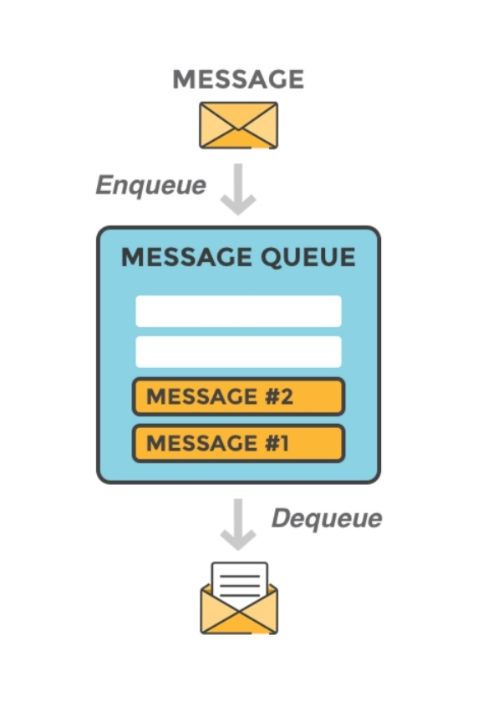
INTRODUCTION
Message queuing allows applications to communicate by sending messages to each other. The message queue provides temporary message storage when the destination program is busy or not connected.
A message queue is a queue of messages sent between applications. It includes a sequence of work objects that are waiting to be processed.

Slide 3
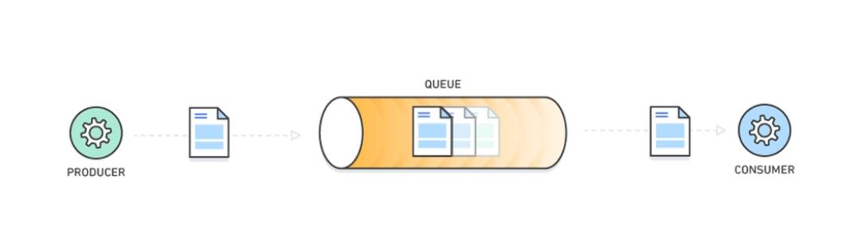
INTRODUCTION
The basic architecture of a message queue is simple there are client applications called producers that create messages and deliver them to the message queue. Another application, called a consumer, connects to the queue and gets the messages to be processed. Messages placed onto the queue are stored until the consumer retrieves them and does something with it.

Slide 4
STYLES OF MESSAGE QUEUING
POINT-TO-POINT
One message is placed on the queue and one application receives that message. In point-to-point messaging, a sending application must know information about the receiving application before it can send a message to that application. For example, the sending application might need to know the name of the queue to which to send the information, and might also specify a queue manager name.

Slide 5
STYLES OF MESSAGE QUEUING
2. PUBLISH/SUBSCRIBE
A copy of each message published by a publishing application is delivered to every interested application. There might be many, one, or no interested applications. In publish/subscribe an interested application is known as a subscriber and the messages are queued on a queue identified by a subscription.

Slide 6
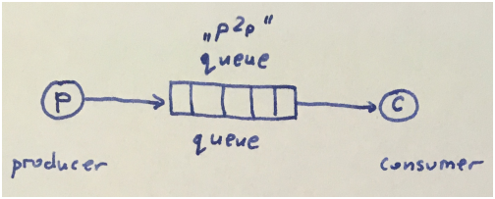
MESSAGE QUEUE USAGE EXAMPLES
Message queues can be used in various ways.
Message queue as a point-to-point connection
We can use named queue to send data from a point directly to another point

Slide 7
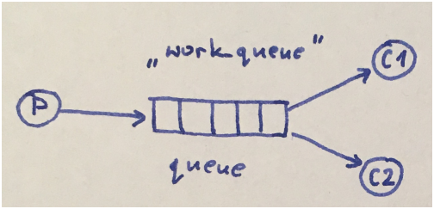
2) Message queue as work queues
We can use named queue to distribute time-consuming tasks among multiple workers (in such a case message queue is called work queue or task queue).

Slide 8
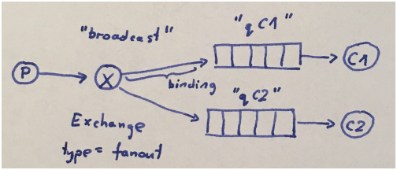
3) Message queue as a broadcast publish-subscribe channel
We can use message queue to deliver a message to multiple consumers with broadcast (fanout) exchange. The fanout exchange is very simple -- it just broadcasts all the messages it receives to all the queues it knows.

Slide 9
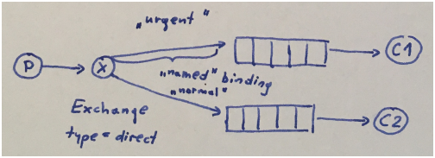
4) Message queue as a publish-subscribe channel with bindings
We can use message queue to deliver a subset of message to multiple consumers with direct exchange. The routing algorithm behind a direct exchange is simple -- a message goes to the queues whose binding key exactly matches the routing key of the message.

Slide 10
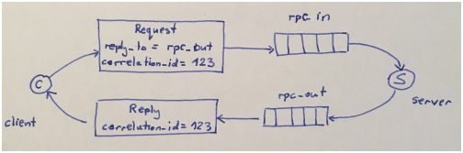
5) Message queue as a Remote Procedure Call
We can use message queue to run a function on a remote computer and wait for the result -- we can make so called Remote Procedure Call.

Slide 11
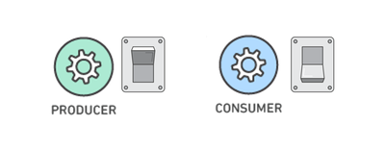
BENEFITS
Better Performance
Producers can add requests to the queue without waiting for them to be processed and consumers process messages only when they are available. No component in the system is ever stalled waiting for another.

Slide 12
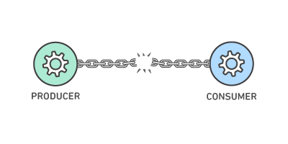
Simplified Decoupling
This allows different parts of the application to evolve independently, be written in different languages, and be maintained by separate development teams.
Monitoring
Message queuing systems enable you to monitor how many items are in a queue, the rate of processing messages, and other stats.

Slide 13
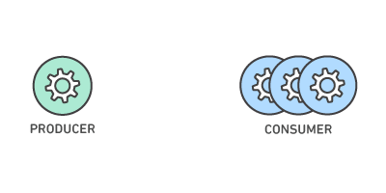
Reliable message delivery
With this feature in place, additional de-duplication or loss-prevention logic is unnecessary.
Improved Scalability
As your queues get longer with the incoming requests, you can distribute the workload across a fleet of consumers.

Slide 14
Improved Security
Authentication
Encryption
Versatility
Message queue solutions can support multiple languages. They can also support numerous application programing interfaces (APIs) and protocols such as
MQTT - Message Queue Telemetry Transport
AMQP - Advanced Message Queuing Protocol
REST - Representational State Transfer

Slide 15
SOME REAL LIFE EXAMPLES

Slide 16
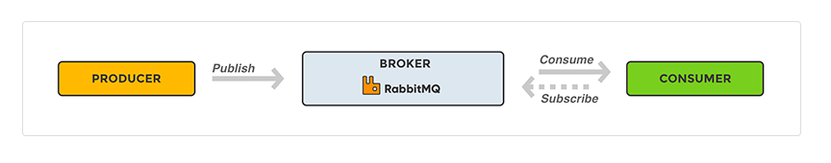
RabbitMQ
RabbitMQ is a message-queueing software also known as a message broker or queue manager.
A message broker acts as a middleman for various services (e.g. a web application)

Slide 17
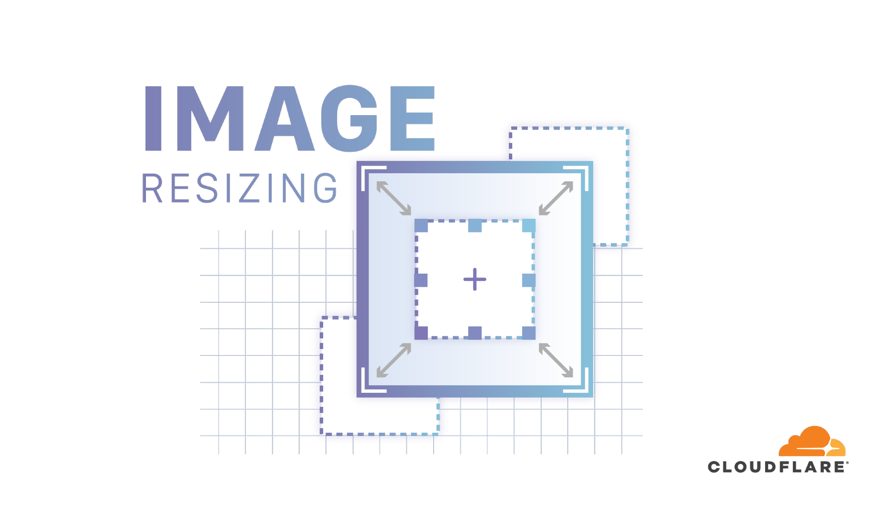
Picture resize
User uploads pictures to a website. They need to be resized, or maybe thumbnails have to be created of those to show a preview somewhere. The user does not bother about this. He should not have to wait for the website to process them before having a response. So this task is queued to somewhere else. The result of the resizing task does not impact the response.

Slide 18
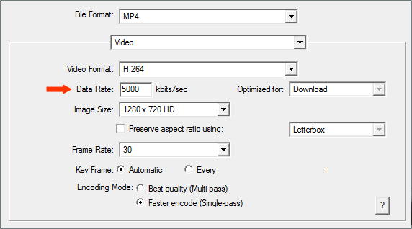
Video encoding
If you're building Youtube, you probably are not going to ask your user to wait until his video has been converted from avi to flash / x264 / webM before telling him his file was uploaded correctly.

Slide 19
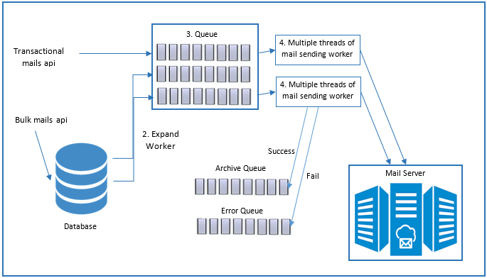
Sending emails

Slide 20
Pushing a tweet
If a user has set his account on any website/blog, has to be integrated with his twitter account. If his blog post has been saved and published, it's enough for the user to be notified that everything is fine. And then put the tweet to be sent in a message queue so that another server will do that. It’s not a problem if blogs are as single instances, but if this is part of the response generation, then what happens when twitter is down? Can you still save your post? If yes, then the tweet won't be sent... If it's in a message queue, even with twitter down (or exceeding your twitter api limit), the message will stay there until it can actually be consumed.

Slide 21
THANK YOU!

